Slide 1
Creating High-Quality Communications Products

Slide 2
What Are Communications Products?
A communications (comms) product is an item (such as a Fact Sheet, Infographic, Newsletter, PowerPoint, Video, etc.) intended to relay a message to an audience in a way that is easy to digest and understand.
They can be internal (created for employees) or external (created for people outside of the company).
Comms products should provide value to both the audience and your office or agency.

Slide 3
Why Are Quality Comms Products Important?
Developing quality comms products is extremely important since they can be used to:
Secure funding and internal project support
Influence stakeholders (thus enabling a project goal to be achieved)
Magnify the impact of your project
Spread awareness of a problem or issue and your intended solution
Inform others of new policies or procedures
Create teaching or training materials

Slide 4
Things To Take into Consideration When making Comms Products
High quality comms products take several factors into consideration:
Audience – Who are they, and what do they need and want? Are they internal or external? What level of knowledge do they have?
Objective – What do you want to share with your audience? Is the message clear? Is it inspirational?
Medium – How will you reach your audience? What methods or tools would work best?
Consistency – Using colors, logos, slogans, images, etc., that are “on-brand” with ACF.

Slide 5
Typical ACF Comms Products
Some typical ACF communications products include:
Fact Sheets – Documents giving useful information about a particular issue
Infographics – Visuals (like illustrations or charts) used to represent information or data
Newsletters – Bulletins that are issued/emailed periodically
PowerPoints – Collections of slides used as visual aids during pitches or presentations
Videos – Recordings published to social media outlets (YouTube, Instagram, etc.)

Slide 6
Fact Sheets
A fact sheet is a document (typically one or two pages) to share information in a concise and easy-to-read format.
It provides an overview of a topic or subject (mostly) via text.
It may also include statistics, facts, and figures.

Slide 7
Fact Sheet Best Practices
Keep text brief and write in active voice
Define key words or concepts
Simplify complex ideas - Give examples to clarify a concept
Consider using a graphic to reinforce information
Provide easy-to-follow steps to describe a process
Keep any graphic(s) you might use simple and easy-to-understand
Search for comparisons and everyday analogies to explain complicated processes
Use bulleted lists, tables, and charts instead of narrative text
Fact sheet templates are available in ACF’s Digital Toolbox

Slide 8
Infographics
An infographic (unlike a fact sheet) is a visually focused representation of information.
It uses a combination of visuals, minimal text, data, and charts to convey info in a memorable way that is easy to understand.
Infographics are often used to communicate complex information in a simple and engaging way.
Infographics should be used to support other content and should not be the only content or way to communicate the information.

Slide 9
Infographic Best Practices
Create an outline – Decide what’s essential
Have a clear title – Define what your infographic is about
Choose the right fonts – Complement the topic of your infographic
Choose the right colors – Stay “on-brand” and contrast accessible
Keep it clean and simple – Leave white space between each statistic
Use graphics to reinforce information – Instead of text, use visual elements to show your data
Use an easy-to-follow layout – Organize it in a way that flows and tells a visual story
Use branding – Incorporate ACF logo to increase brand recognition
Ensure your design is 508-compliant and meets ACF visual style guide standards

Slide 10
Infographic Templates
Unless you’re a graphic designer, you won’t want to design your own infographic from scratch.
Some good sources for templates that you can adjust to fit your needs include:
Canva
Visme
Venngage
Piktochart
Adobe
Buffer
Snappa
Vista

Slide 11
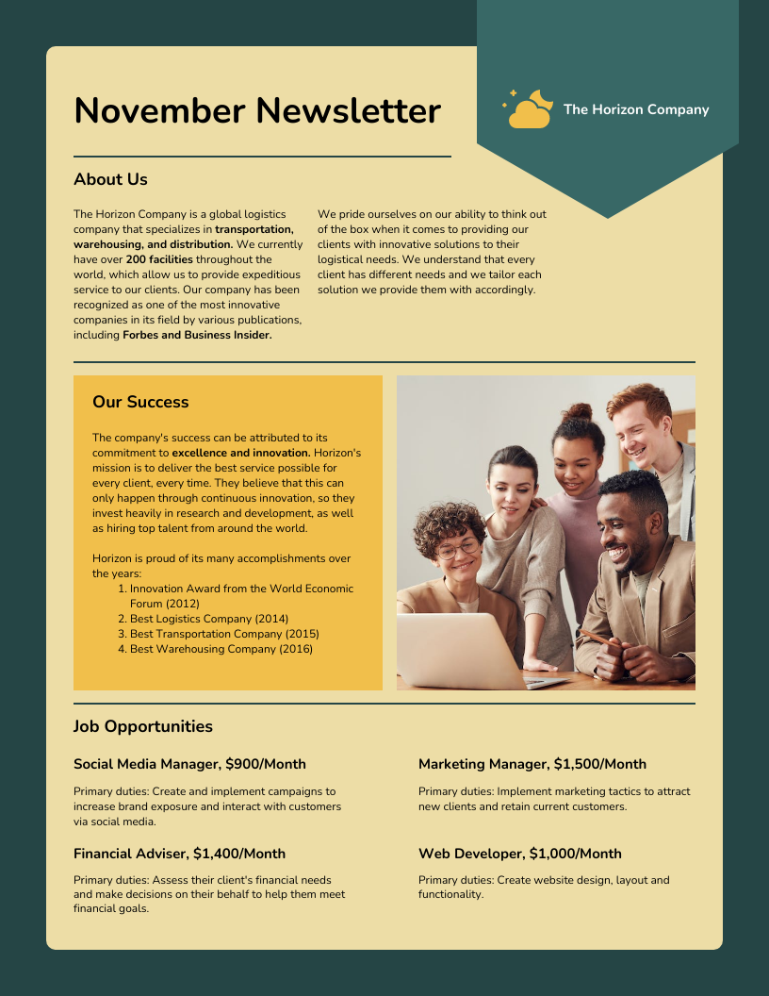
Newsletters
A tool used by organizations to share relevant and valuable information with subscribers.
Gives audience direct access to your content.

Slide 12
Newsletter Best Practices
Readability – Use brief, catchy headlines, and section labels to draw attention
Storytelling Value – Storify content to create a richer experience that your subscribers will anticipate and enjoy reading
Reader Focus – Deliver information and answers your audience wants – not branding messages.
Add a human touch to create a sense of personal connection.
Use first- or second-person pronouns
Write in a conversational tone
Clear Calls To Action – Include short, but descriptive links that guide subscribers to desired next steps (e.g., register for webinar, download a resource, follow you on social media, or share with others)
Attractive, User-Friendly Design – Use appealing, readable fonts and colors.
Include images and subheadings to break up dense sections of text.
Organize information so it’s easy to scan.
Make sure it’s 508 compliant and accessible to EVERYONE!

Slide 13
Newsletter Templates
Pick and customize a template that fits your message!
Additional sources for newsletter templates that you can adjust to fit your needs include:
Canva
Adobe
Microsoft
Piktochart
Visme
Venngage
Omnisend
Vistacreate

Slide 14
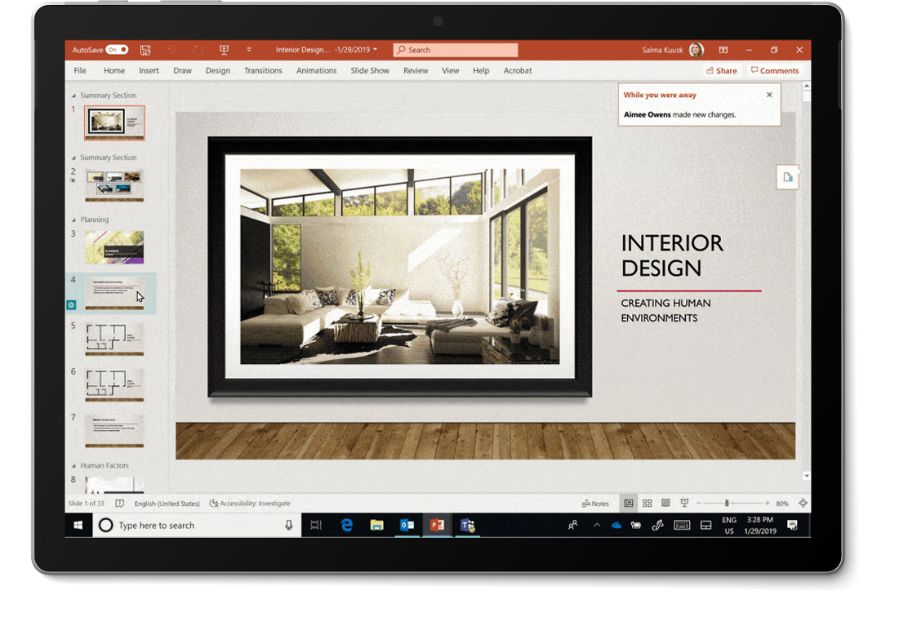
PowerPoints
PowerPoint, an easy-to-use presentation software, to create professional-looking electronic slide shows.
It serves as a visual aid for presenting on various topics, ideas, research, training etc.
Used to convey a message or a story, slide by slide.

Slide 15
PowerPoint Best Practices
Create an outline – Decide what’s essential
Use clear titles – Define what your presentation is about and what each slide covers
Simplify and limit the number of words on each screen - Use key phrases and include only essential information
Keep it clean and simple - Limit punctuation and avoid putting words in all-capital letters. Empty space on the slide enhances readability
Use high quality graphics to reinforce information and to show examples.
Use contrasting colors for text and background. Patterned backgrounds can reduce readability
Avoid overusing flashy transitions and animations like text fly-ins. They can be distracting and get old quickly.
Ensure all presentations are 508 compliant to promote wider reach/access.
Presentation templates are available in ACF’s Digital Toolbox

Slide 16
Videos
Videos combine the explanatory power of imagery, text and audio to share a lot of information efficiently.
They can be a memorable and engaging way you can interact with your customers.
Video helps you connect with and inspire trust in audiences
It’s versatile and is beneficial across various platforms (YouTube, Instagram, Facebook, etc.).

Slide 17
Video Best Practices
Plan your video(s) in advance – Write a script or outline
Have a clear title – Define what your video is about
Use video descriptions for information that is too lengthy to include in your title
Use keywords and hashtags relevant to your subject matter to help people find your video (e.g., nutrition, childcare, etc.)
Cut the fluff from your intro – Don’t include too much filler or people will lose interest
Use an eye-catching thumbnail –Use high contrast colors that stand out
Increase use of short-form videos - 73% of consumers prefer this format to learn about a product or service.
Use playlists – Playlists encourage people to watch more of your content
Promote your video – Sharing clips on multiple social media platforms and promoting your video using email outreach will help your audience find your content

Slide 18
Use High Quality Photos
Images of people make a great personal connection with the viewer.
Images of places provide a good understanding when referencing a location or event.
"Sharpen" your images in a photo editor using the standard sharpen filter (Filter/Sharpen/Sharpen).
Photos should not be over-optimized or degraded in any way. If degradation is noticeable in a photo, do not use it. Find a better-quality photo.

Slide 19
Sources for Images & Licensing
To avoid accidental copyright infringement, do not freely copy/paste images found on other websites — just because it’s online doesn’t mean it’s free.
Even if the image is free to use, always review usage requirements and restrictions. Some can only be used with attribution, or written permission or notification may be required.
This can vary from image to image within the same website.

Slide 20
Stock Photos
Try these sources for free stock images:
(Free) Adobe Stock Photos
Flickr Creative Commons Group
CDC Public Health Image Library (PHIL)
USAgov Image Search
Pixabay
Unsplash
Freepik
Pexels

Slide 21
Use Diverse Images
Addressing diversity and inclusiveness in your stock images will only serve to widen your audience when you include more skin tones, body shapes, abilities or gender. You have an opportunity to reach an even wider audience by including people from typically underrepresented communities in your imagery.

Slide 22
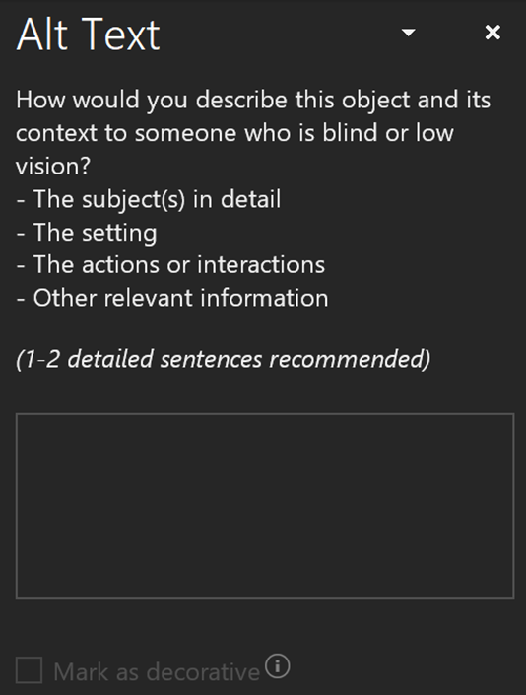
Don’t Forget To Include Meaningful Alt Text!
Alt text will display for users when their device cannot download images, or when they have poor internet connection.
Providing alt text helps to ensure your content complies with Section 508 standards.
To be 508 compliant, alt text must be both present and contextually relevant

Slide 23
Conclusion
By following the guidelines that were just outlined, you can effectively create and/or use high quality communications products that are both informative and visually appealing.

